Slide 1



Optimizing Smartphone Power Consumption through Dynamic Resolution Scaling
Songtao He^{1,2}, Yunxin Liu¹, Hucheng Zhou¹
¹Microsoft Research, Beijing, China
²University of Science and Technology of China, Hefei, China

Slide 2
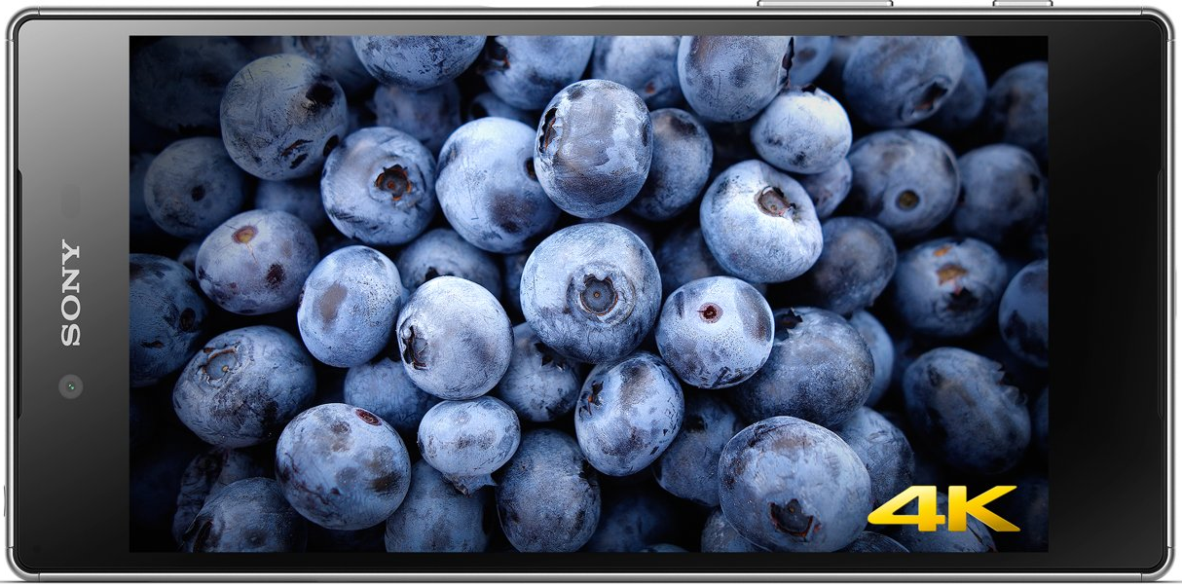
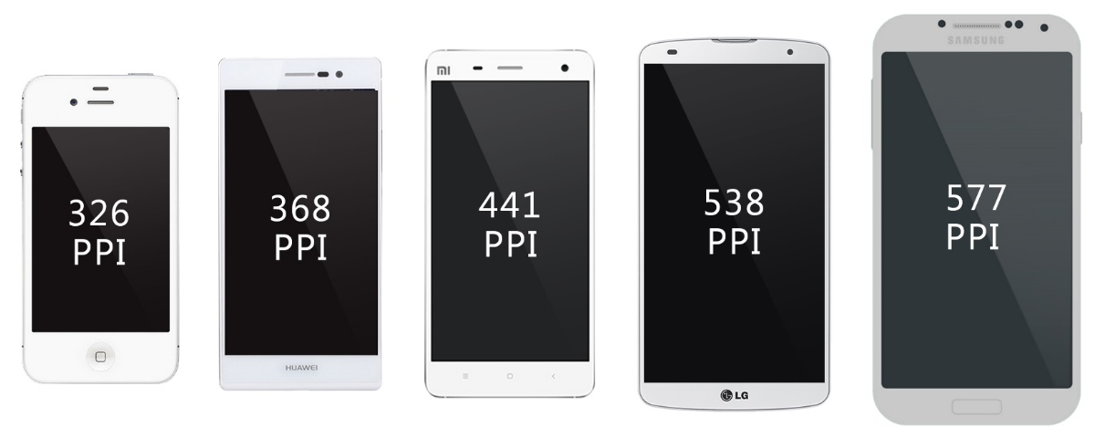
The “Arms Race” on display density
806 PPI
3840x2160
“Retina display”
Resolution: 720P (1280x720) -> 1080P (1920x1080) -> 2K (2560x1440)

Slide 3
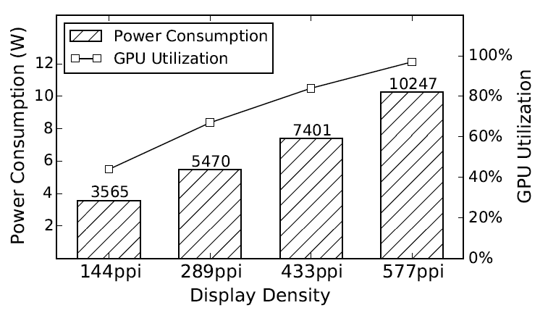
High display density -> high power cost
High system resource usage
High GPU load
More memory and more memory bandwidth
Significantly-reduced battery life
System power and GPU utilization in different display density (Galaxy S5 LTE-A)

Slide 4
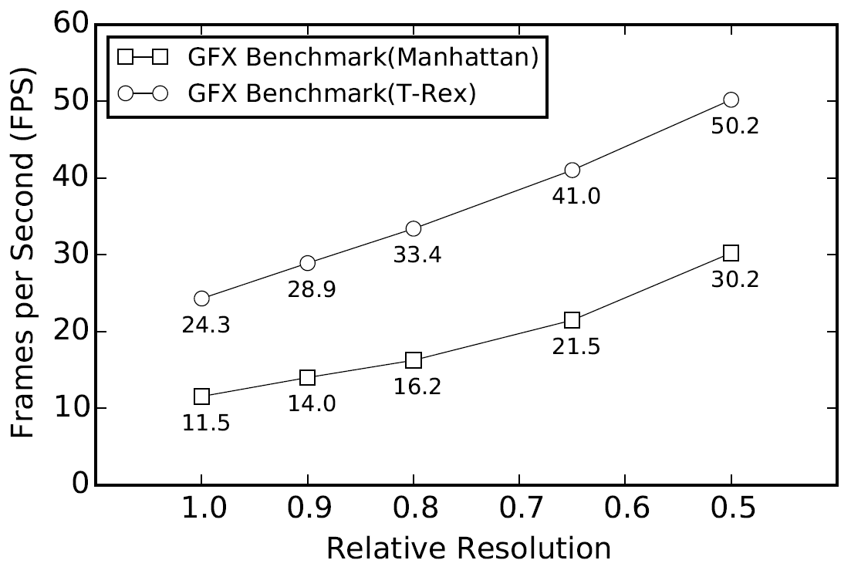
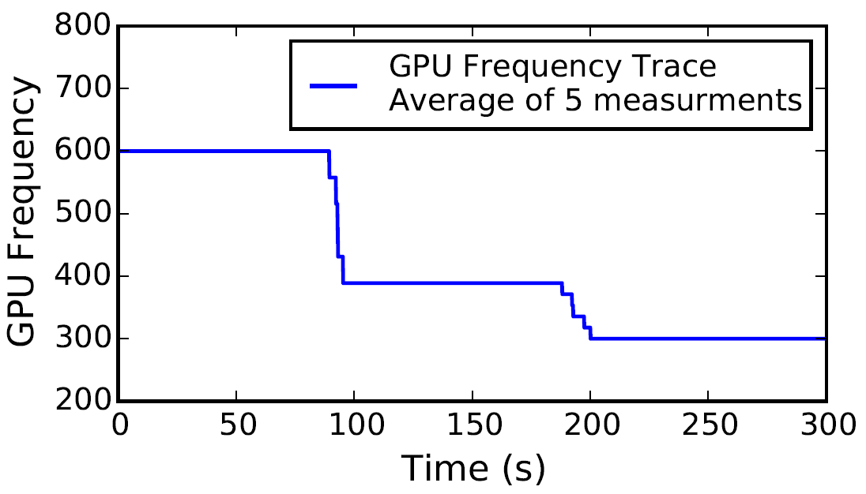
High display density -> compromised UX
Reduced frame rate
Overheating
GFX benchmark frame rate in deferent display resolutions (Galaxy S5 LTE-A)
GPU frequency in running the Ridge Racer Slipstream game (Galaxy S5 LTE-A)

Slide 5
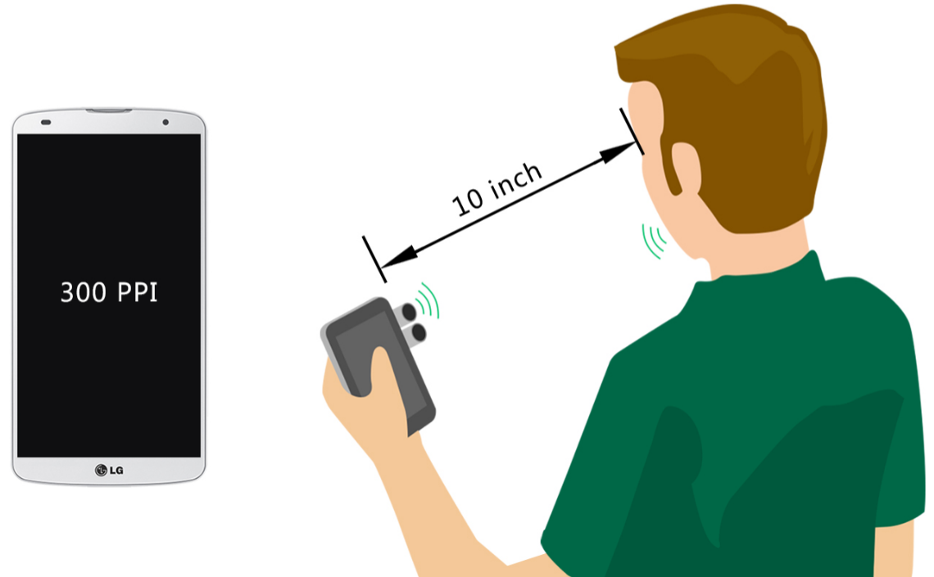
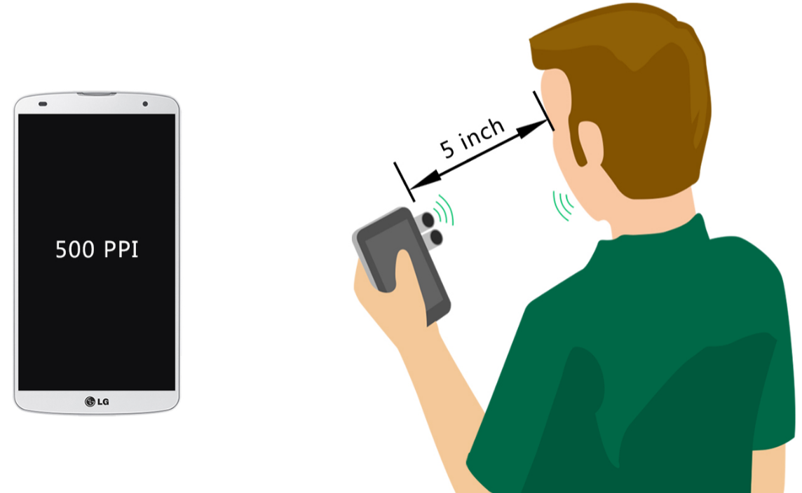
Solution: Dynamic Resolution Scaling (DRS)
Automatically adjust display resolution based user-screen distance
300 PPI

Slide 6
Requirements and challenges
Change display resolution on the fly
Real-time, per-frame
No changes to apps and ROM
Transparent from users
Measure user-screen distance
Real-time
Accurately
Low power cost

Slide 7
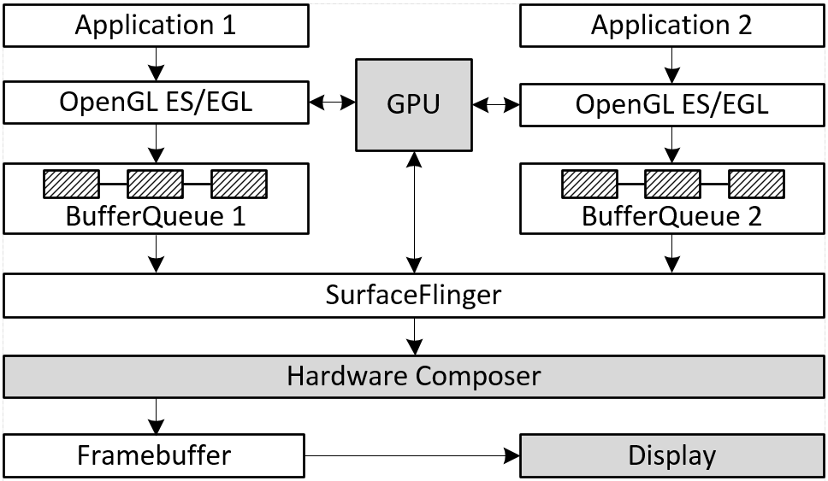
Background: Android graphics architecture

Slide 8
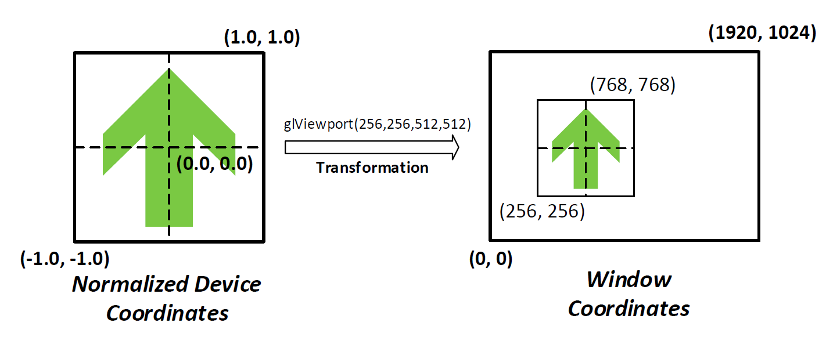
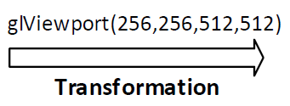
Background: GPU graphics pipelines
Vertex processing
Pixel processing
Opportunity to reduce GPU workload via DRS

Slide 9
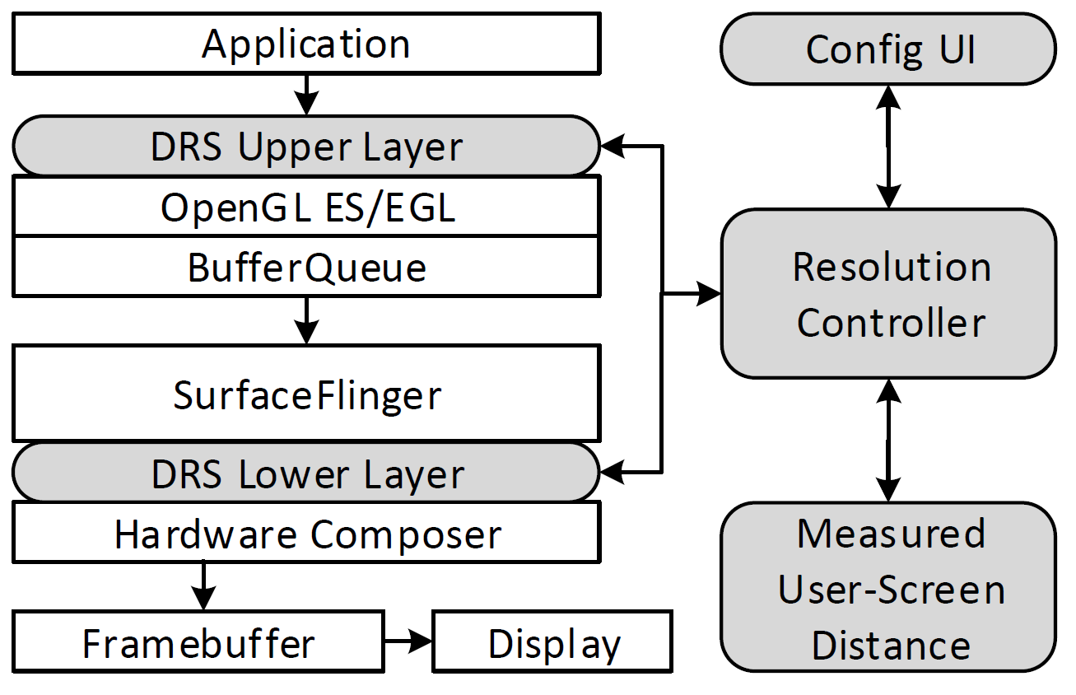
Enable DRS through OpenGL-API interception
No modifications to apps and OS
Work with legacy apps
No ROM changes
Two interception layers
Upper layer: adjusts display resolution
Lower layer: handles composition

Slide 10
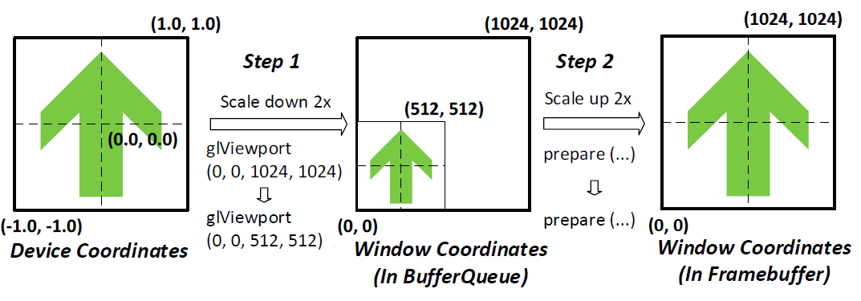
Scale resolution down&up to reduce GPU workload
Upper layer
Lower layer
Ensure correctness: the same scaling factor must be used for the same frame in the two DRS layers

Slide 11
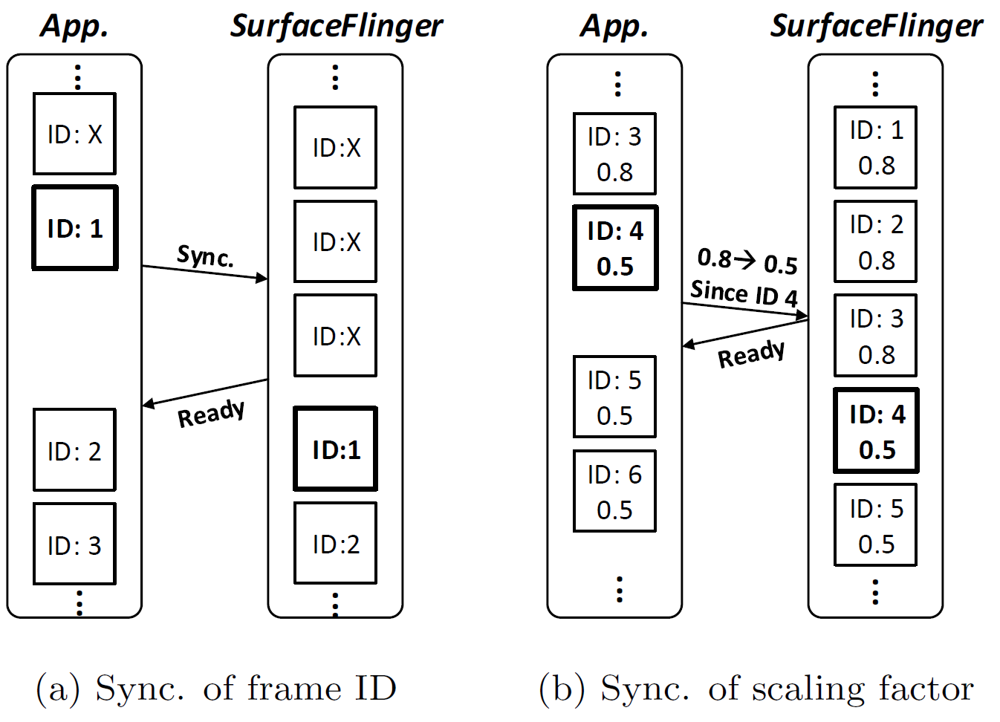
Frame synchronization between DRS layers
< 34 ms
< 1ms
Sync frame ID
Sync scaling factor

Slide 12
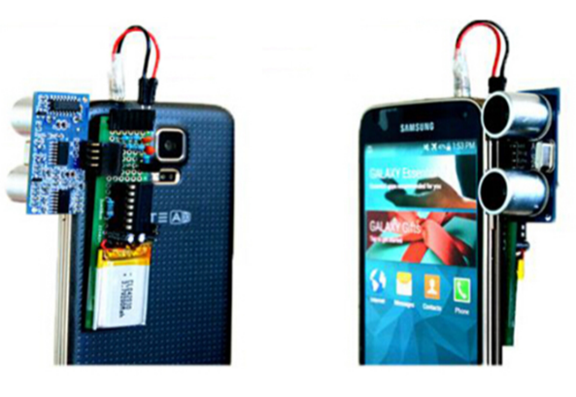
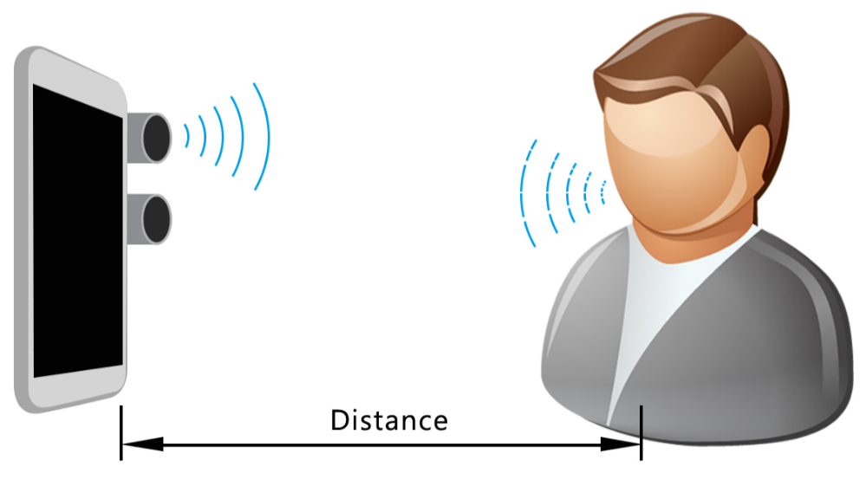
Ultrasonic based user-screen-distance detection
HC-SR04 ultrasonic sensors
MSP430 micro processor
Real-time, accurate, and low-power
40 KHz, ± 3mm, 5-6 mW

Slide 13
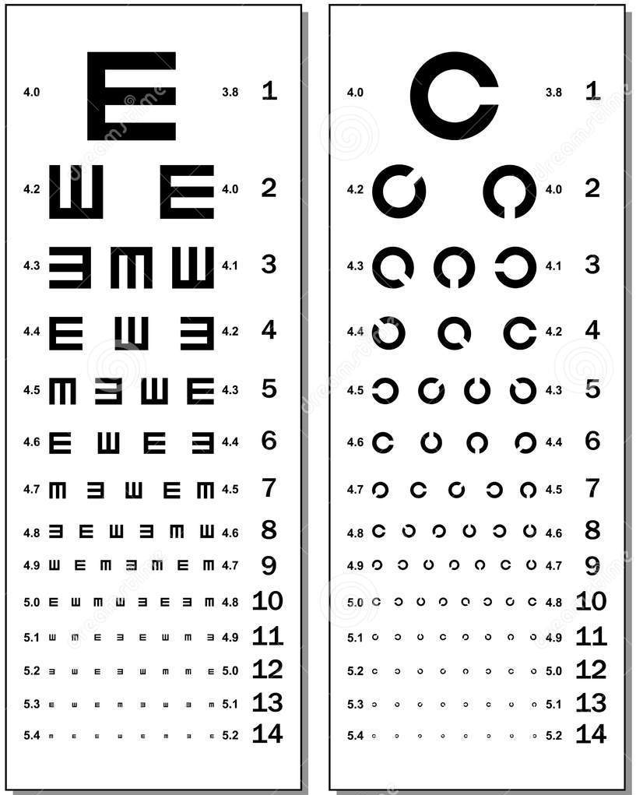
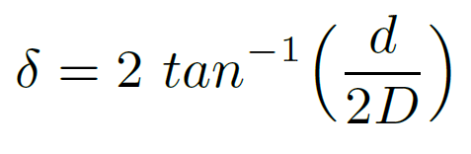


Determine the best display resolution
Maximize both user experience and power saving
Based on existing knowledge on human visual acuity

Slide 14
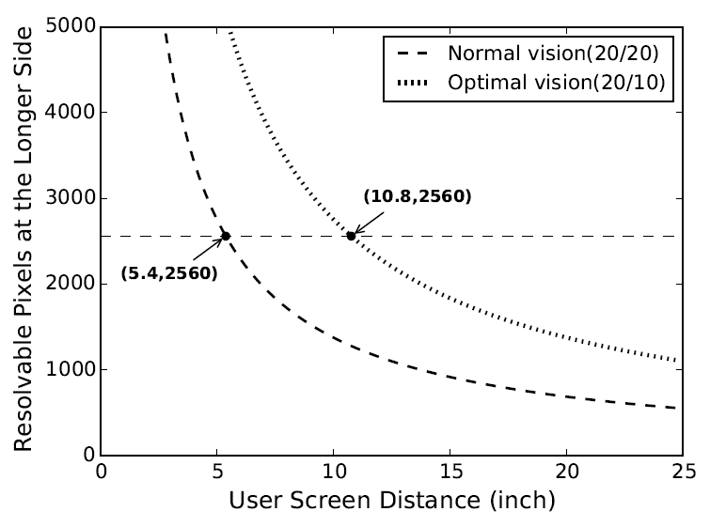
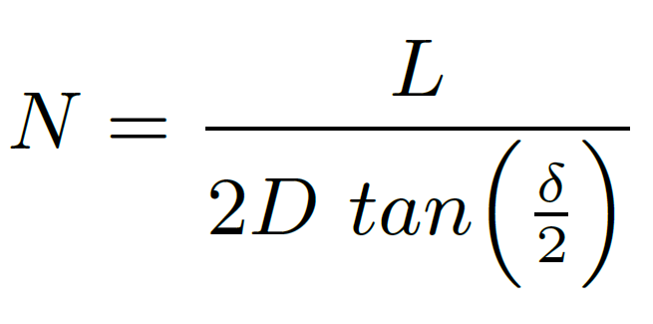
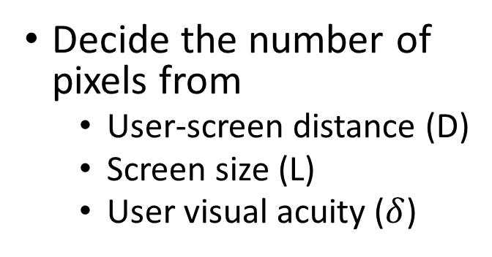
Apply it to DRS
Decide the number of pixels from
User-screen distance (D)
Screen size (L)
User visual acuity ($δ$)

Slide 15
Evaluation
Samsung Galaxy S5 LTE-A smartphone
2560x1440 pixels, 577 PPI, Adreno 420 GPU
Samsung-customized ROM based on Android 4.4.2
30 GPU-intensive games
Package size: 12 > 500 MB, 2 > 1,500 MB
Our implementation supports all of them
Monsoon power monitor to measure system power
14 games + 1 graphics benchmark (two scenes)

Slide 16
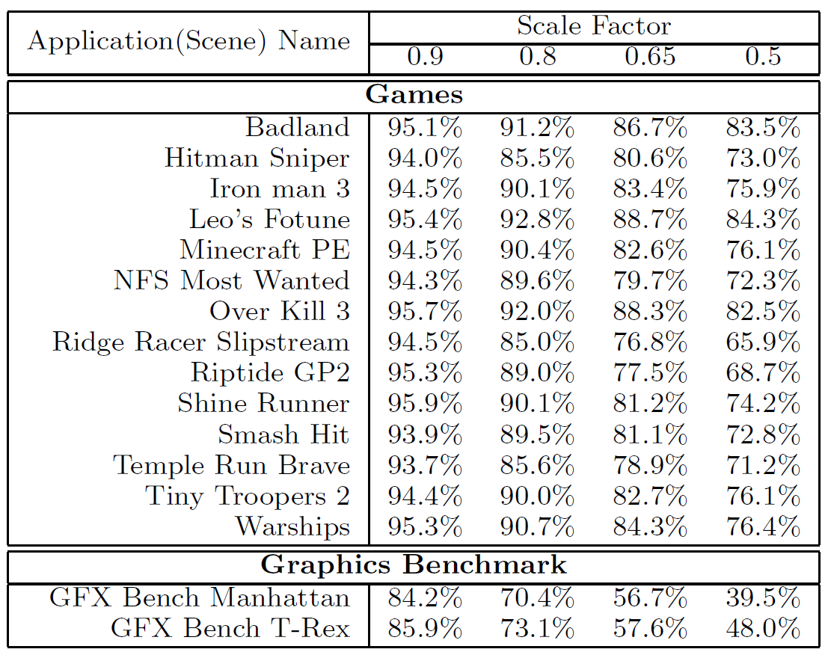
Savings of Energy Per Frame (EPF)
On average 30.1% (up to 60.5%) EPF saving by halving the resolution
2560x1440 -> 1280x720
Assuming optimal vision
29.4% average saving for the 14 games
More saving for normal vision

Slide 17
User study
10 young students with at least normal vision
Play two games (Smash Hit and Temple Run Brave) for 10 minutes
Randomly enable DRS for the first 5 minutes or the second 5 minutes
Participants encouraged to change their postures and viewing distance freely
None of them could tell the existence of DRS
Even with 136 times resolution changes for each participant in average
Live demo available during demo session, try it yourselves!

Slide 18
Summary
Users suffer from extremely-high display density of smartphones
The first DRS system for smartphones
Real-time, per-frame DRS
Work on existing commercial smartphones and support legacy apps
Automatic DRS with measured user-screen distance or manually configured
Ultrasonic based user-screen distance detection
Real-time, accurate, low power, and cheap

Slide 19
Thanks!
yunxin.liu@microsoft.com

